Slide 1
Object Oriented Programming I : Lecture 4
Ahmed Imteaj
Lecturer
Dept. of CSE, IIUC

Slide 2
Friend Function
It is possible to grant a nonmember function access to the private members of a class by using a friend.
A friend function has access to all private and protected members of the class for which it is a friend.
To declare a friend function, include its prototype within the class, preceding it with the keyword friend.

Slide 3
Friend Function
#include <iostream>
using namespace std;
class myclass {
int a, b;
public:
friend int sum(myclass x);
void set_ab(int i, int j);
};
void myclass::set_ab(int i, int j)
{
a = i;
b = j;
}
// Note: sum() is not a member function of any class.
int sum(myclass x)
{
return x.a + x.b;
}
int main()
{
myclass n;
n.set_ab(3, 4);
cout << sum(n);
return 0

Slide 4
Friend Function
H.W. : Self Study:
A function friendly to two classes (Balagurusamy, page 127)
Swapping private data of Classes (Balagurusamy, page 129)

Slide 5
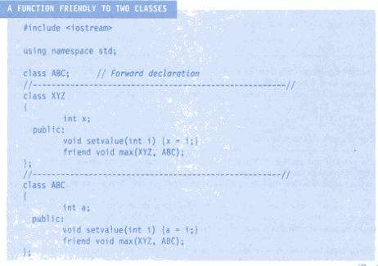
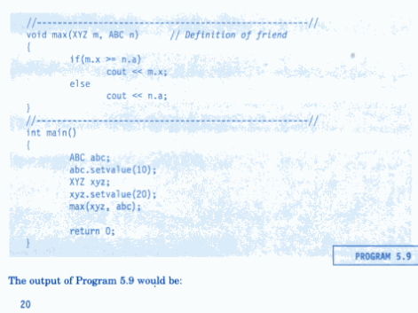

Slide 6
Friend Classes
It is possible for one class to be a friend of another class.
When this is the case, the friend class and all of its member functions have access to the private members defined within the other class.
In the next slide example, class Min has access to the private variables a and b declared within the TwoValues class.

Slide 7
Friend Classes
#include <iostream>
using namespace std;
class TwoValues {
int a;
int b;
public:
TwoValues(int i, int j)
{ a = i; b = j; }
friend class Min;
};
class Min {
public:
int min(TwoValues x);
};
int Min::min(TwoValues x)
{
return x.a < x.b ? x.a : x.b;
}
int main()
{
TwoValues ob(10, 20);
Min m;
cout << m.min(ob);
return 0;
}
Output:
10

Slide 8
Inline Functions
In C++, you can create short functions that are not actually called; rather, their code is expanded in line at the point of each invocation.
Once you define an inline function, using the 'inline' keyword, whenever you call that function the compiler will replace the function call with the actual code from the function.
To cause a function to be expanded in line rather than called, precede its definition with the inline keyword.
All the functions defined inside class definition are by default inline, but you can also make any non-class function inline by using keyword inline with them.

Slide 9
For example, in this program, the function max() is expanded in line instead of called:
Inline Functions
As far as the compiler is concerned, the preceding program is equivalent to this one:
#include <iostream>
using namespace std;
int main()
{
cout << (10>20 ? 10 : 20);
cout << " " << (99>88 ? 99 : 88);
return 0;
}
#include <iostream>
using namespace std;
inline int max(int a, int b)
{
return a>b ? a : b;
}
int main()
{
cout << max(10, 20);
cout << " " << max(99, 88);
return 0;
}

Slide 10
Inline Functions
The reason that inline functions are an important addition to C++ is that they allow you to create very efficient code. Since classes typically require several frequently executed interface functions (which provide access to private data), the efficiency of these functions is of critical concern.
As you probably know, each time a function is called, a significant amount of overhead is generated by the calling and return mechanism.
Typically, arguments are pushed onto the stack and various registers are saved when a function is called, and then restored when the function returns. The trouble is that these instructions take time. However, when a function is expanded in line, none of those operations occur.

Slide 11
Automatic Inline Functions
It is possible to define short functions completely within a class declaration.
When a function is defined inside a class declaration, it is automatically made into an inline function (if possible).
All the member functions defined inside the class definition are by default declared as Inline.
It is not necessary (but not an error) to precede its declaration with the inline keyword.
For example, the preceding program is rewritten here with the definitions of init() and show() contained within the declaration of myclass:

Slide 12
Automatic Inline Functions
#include <iostream>
using namespace std;
class myclass {
int a, b;
public:
// automatic inline
void init(int i, int j) { a=i; b=j; }
void show() { cout << a << " " << b << "\n"; }
};
int main()
{
myclass x;
x.init(10, 20);
x.show();
return 0;
}

Slide 13
Arrays of Objects
In C++, it is possible to have arrays of objects. The syntax for declaring and using an object array is exactly the same as it is for any other type of array. For example, this program uses a three-element array of objects:
#include <iostream>
using namespace std;
class cl {
int i;
public:
void set_i(int j) { i=j; }
int get_i() { return i; }
};
int main()
{
cl ob[3];
int i;
for(i=0; i<3; i++) ob[i].set_i(i+1);
for(i=0; i<3; i++)
cout << ob[i].get_i() << "\n";
return 0;
}

Slide 14
Arrays of Objects
Here is a slightly different version of the preceding program that uses an initialization:
#include <iostream>
using namespace std;
class cl {
int i;
public:
cl(int j) { i=j; } // constructor
int get_i() { return i; }
};
int main()
{
cl ob[3] = {1, 2, 3}; // initializers
int i;
for(i=0; i<3; i++)
cout << ob[i].get_i() << "\n";
return 0;
}

Slide 15
Arrays of Objects
If an object's constructor requires two or more arguments, you will have to use the longer initialization form. For example,
#include <iostream>
using namespace std;
class cl {
int h;
int i;
public:
cl(int j, int k)
{ h=j; i=k; } // constructor with 2 parameters
int get_i() {return i;}
int get_h() {return h;}
};
int main()
{
cl ob[3] = {
cl(1, 2),
cl(3, 4),
cl(5, 6)
};
int i;
for(i=0; i<3; i++) {
cout << ob[i].get_h();
cout << ", ";
cout << ob[i].get_i() << "\n";
}
return 0;
}

Slide 16
Pointers to Objects
Just as you can have pointers to other types of variables, you can have pointers to objects. When accessing members of a class given a pointer to an object, use the arrow (–>) operator instead of the dot operator.
#include <iostream>
using namespace std;
class cl {
int i;
public:
cl(int j) { i=j; }
int get_i() { return i; }
};
int main()
{
cl ob(88), *p;
p = &ob; // get address of ob
cout << p->get_i();
return 0;
}

Slide 17
Pointers to Objects
int main()
{
cl ob[3] = {1, 2, 3};
cl *p;
int i;
p = ob; // get start of array
for(i=0; i<3; i++) {
cout << p->get_i() << "\n";
p++; // point to next object
}
return 0;
}
#include <iostream>
using namespace std;
class cl {
int i;
public:
cl() { i=0; }
cl(int j) { i=j; }
int get_i() { return i; }
};

Slide 18
This Pointer
The this pointer is very important when operators are overloaded and whenever a member function must utilize a pointer to the object that invoked it.
#include <iostream>
using namespace std;
class Box {
public:
Box(double l = 2.0, double b = 2.0)
{cout <<"Constructor called." << endl;
length = l;
breadth = b;}
double Area() {
return length * breadth;
}
int compare(Box box) {
return this-> Area () > box. Area();
}
private:
double length; // Length of a box
double breadth; // Breadth of a box
};
int main() {
Box Box1(3.3, 1.2); // Declare box1
Box Box2(8.5, 6.0); // Declare box2
if(Box1.compare(Box2)) {
cout << "Box2 is smaller than Box1“
<<endl;
} else {
cout << "Box2 is equal to or larger
than Box1" <<endl;
}
return 0;
}

Slide 19
Passing References to Objects
When an object is passed as an argument to a function, a copy of that object is made. When the function terminates, the copy's destructor is called.
If for some reason you do not want the destructor function to be called, simply pass the object by reference.
When you pass by reference, no copy of the object is made. This means that no object used as a parameter is destroyed when the function terminates, and the parameter's destructor is not called.
For example, try this program:

Slide 20
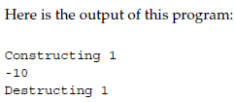
Passing References to Objects
#include <iostream>
using namespace std;
class cl {
int id;
public:
int i;
cl(int i);
~cl();
void neg(cl &o) { o.i = -o.i; }
};
cl::cl(int num)
{
cout << "Constructing " << num << "\n";
id = num;
}
cl::~cl()
{
cout << "Destructing " << id << "\n";
}
int main()
{
cl o(1);
o.i = 10;
o.neg(o);
cout << o.i << "\n";
return 0;
}

Slide 21
Returning References
#include <iostream>
using namespace std;
char s[80] = "Hello There";
char &replace(int i)
{
return s[i];
}
int main()
{
replace(5) = 'X'; // assign X to space after Hello
cout << s;
return 0;
}
This program replaces the space between Hello and There with an X. That is, the
program displays HelloXthere. Take a look at how this is accomplished. First, replace()
is declared as returning a reference to a character. As replace() is coded, it returns a
reference to the element of s that is specified by its argument i. The reference returned
by replace() is then used in main() to assign to that element the character X.
Output:
HelloXThere

Slide 22
Thank You!!

